Slide 1
TOOLS AND TECHNOLOGIES FOR SOFTWARE TESTING
( Chapter 4 )
Software Testing and Quality Assurance

Slide 2
Tools and Technologies for Software Testing
To address this complexity and enhance the effectiveness and efficiency of testing, a wide range of tools and technologies have been developed. These tools and technologies automate various aspects of testing, providing benefits such as faster feedback, increased test coverage, and improved accuracy.
One of the most significant advancements in software testing is the use of test automation.
Test automation utilizes software to control test execution, compare actual outcomes to expected outcomes, set up preconditions, and generate test reports. This automation frees up testers from repetitive tasks and allows them to focus on more exploratory and strategic testing activities.
The selection and implementation of appropriate testing tools and technologies are crucial for successful software testing. Factors to consider when choosing tools include:
  the type of software being tested,
  the testing goals,
  the budget,
  the expertise of the testing team.

Slide 3
Test Automation Frameworks
A test automation framework provides a structure and guidelines for developing and executing automated tests.
It typically includes components such as:
Test Runner: The test runner executes the tests and generates reports.
Test Libraries: These libraries provide reusable functions and methods for interacting with the application under test and performing assertions.
Test Data Management: Frameworks often include mechanisms for managing test data, allowing testers to separate test data from test scripts and easily create variations of test data.

Slide 4
Test Automation Features
Complex Systems: When dealing with complex software systems, test automation architecture helps manage the intricacies. It ensures that testing efforts are well-organized and efficient.
Regression Testing: For repetitive regression testing, a test architecture provides a systematic approach. It allows you to maintain and execute test suites across different releases or versions.
Scalability: As a project grows, having a well-defined architecture ensures scalability. It accommodates new features, modules, and integrations without compromising testing quality.
Cross-Platform Testing: When testing across multiple platforms (web, mobile, desktop), an architecture helps standardize processes and tools.
Parallel Execution: If there is a need to run tests concurrently, an architecture guides you in setting up parallel execution environments.

Slide 5
Common Architecture in Software Testing Tools
User Interface Layer: Provides dashboards for designing, executing tests, and viewing results.
Test Management Layer: Manages test cases, versioning, and repositories.
Automation Layer: Automates test execution using runners and interaction modules.
Integration Layer: Connects to CI/CD tools, defect tracking, and version control.
Execution Layer: Simulates user actions or API calls; supports distributed testing.
Reporting Layer: Aggregates results and visualizes performance metrics.
Data Management Layer: Handles synthetic data generation and secure storage.
Security and Logging Layer: Secures access and logs execution details.

Slide 6
Automated Testing Tools
These tools enable testers to automate repetitive tasks, such as regression testing, and focus on more complex testing activities.
Here are some examples of popular automated testing tools categorized by their functionality:
Unit Testing Frameworks: These frameworks are used to write and execute unit tests, which focus on testing individual units of code in isolation.
  JUnit (Java): JUnit is a widely used unit testing framework for Java, as noted in source and the conversation history. It provides annotations for defining test methods, assertions for verifying expected outcomes, and test runners for executing tests and generating reports.
  Robot (Pyton): open-source unit testing framework is developed and operates using Python. This multi-platform unit testing framework can run tests at different levels in real or simulated user environments.
  PyUnit (Python): PyUnit is essentially Python’s unit testing framework. It is a Python language version of JUnit

Slide 7
GUI Testing Tools
GUI Testing Tools: These tools are designed to automate the testing of graphical user interfaces, simulating user interactions such as clicking buttons, entering text, and navigating menus.
Selenium: Selenium is a widely used open-source framework for automating web browsers. It supports multiple programming languages and browsers, allowing testers to write scripts that interact with web pages and verify their behavior.
Silk Test: SilkTest is a commercial GUI testing tool known for its robust object recognition capabilities and support for various platforms.
Cypress : Cypress allows the tester to carry out two essential testing flows: End-to-End testing and Component testing.
TestComplete: TestComplete is another commercial GUI testing tool offering a comprehensive set of features for automating desktop, web, and mobile applications.

Slide 8
API Testing Tools
API Testing Tools: These tools are used to test application programming interfaces (APIs) by sending requests to the API and verifying the responses.
REST Assured: REST Assured is a popular Java library specifically designed for testing RESTful APIs. It simplifies the process of sending HTTP requests, validating responses, and handling authentication and authorization.
Postman: Postman is a widely used platform for API testing, offering a user-friendly interface for composing requests, inspecting responses, and managing collections of API tests.
SoapUI: SoapUI is a tool for testing Web Services; these can be the SOAP Web Services as well RESTful Web Services or HTTP based services. SoapUI is an Open Source and free tool.
Katalon Studio: Katalon is a test automation solution for API, Web, and Mobile; offering different approaches of running tests with low-code, no-code and full-code testing modes.

Slide 9
Performance Testing Tools
The three common key performance indicators in software are availability, throughput/concurrency, and response time. Performance testing tools are used to simulate load on an application and measure its performance under different conditions.
JMeter: JMeter is an open-source tool developed by Apache for performance and load testing. It allows testers to create realistic simulations of user traffic and analyze the application's response times, throughput, and resource utilization.
LoadRunner: LoadRunner is a commercial performance testing tool widely used for testing enterprise applications. It offers advanced features for scripting, load generation, and performance monitoring.
Locust is an open-source, Python-based, and distributed load-testing tool used to measure the performance and scalability of web applications, APIs, and other network-based services.
K6 is an open-source, developer-centric, and performance testing tool designed for load testing and performance testing of web applications and APIs.
Notes:
https://www.geeksforgeeks.org/60-days-of-software-testing/
Gatling is another open-source performance testing tool that uses a domain-specific language.
Apache Benchmark (ab) is another open-source performance testing tool that uses simple command-line arguments.
Lighthouse can be integrated with CI using the cypress-audit tool. The cypress-audit tool integrates Lighthouse with Cypress, allowing you to run performance audits as part of your functional tests in CI.

Slide 10
Load Balancer in Performance Testing
Load Balancer plays a key role in performance testing by distributing traffic across multiple servers, simulating real-world scenarios, and preventing bottlenecks. Some of the key features are:
Traffic Distribution: Ensures even load distribution during tests.
Bottleneck Prevention: Avoids overloading individual servers.
Real-World Simulation: Mimics user traffic from different locations.
Fault Tolerance Testing: Tests resilience by redirecting traffic when a server fails.
Monitoring: Works with tools like JMeter and LoadRunner to track system performance.
Types of Load Balancers:
Hardware Load Balancers: High-performance devices (e.g., F5 Networks).
Software Load Balancers: Flexible, cost-effective solutions (e.g., HAProxy, NGINX).
Cloud Load Balancers: Integrated services in platforms like AWS and Google Cloud.

Slide 11
Security Testing Tools
Security Testing Tools: Security testing tools are used to identify vulnerabilities in software applications and assess their security posture.
OWASP ZAP: OWASP ZAP (Zed Attack Proxy) is a popular open-source security testing tool. It can be used to scan web applications for vulnerabilities and perform penetration testing to assess their resilience to attacks.
Burp Suite: Burp Suite is a widely used web security testing toolkit. It provides a comprehensive suite of tools for intercepting and modifying HTTP requests, analyzing application behavior, and identifying security vulnerabilities.
SQL Map: open-source penetration testing tool that automates the process of detecting and exploiting SQL injection flaws and taking over of database servers.

Slide 12
PenTesting
Penetration testing (PenTesting) identifies vulnerabilities, evaluates risks, and strengthens system security through simulated real-world attacks using techniques such as SQL Injection, XSS, Buffer Overflow, and Privilege Escalation.
Penetration Testing Phases:
  Reconnaissance: Gathering information using tools like Nmap and Shodan.
  Vulnerability Assessment: Scanning with tools such as Nessus and OpenVAS.
  Exploitation: Gaining unauthorized access using Metasploit or Cobalt Strike.
  Post-Exploitation: Extracting data or testing lateral movement.
  Reporting: Documenting vulnerabilities and providing recommendations.
Different types of Pen Testing:
  Black Box: Simulates external attacks without prior knowledge.
  White Box: Tests with full system knowledge.
  Gray Box: Combines black and white box testing.

Slide 13
Software Data Testing Tools
Test Data Generation
Used to create synthetic data for testing purposes when real data is unavailable or impractical.
Test data generation tools create datasets based on specified rules, such as user details, product information, or transaction records.
Example: When testing a shopping cart, a tool like Mockaroo/Faker might generate random but realistic user data, including addresses, emails, and order histories, to simulate various user interactions.
Test Data Masking
Protects sensitive data by obfuscating it, ensuring that it cannot be accessed or misused during testing.
Data masking tools replace sensitive information (such as credit card numbers, personal identification details, etc.) with fictional but valid data.
Example: If a company is using real customer data for testing, a tool like Delphix can mask personal information like names and addresses while preserving the data structure for testing purposes.
Test Data Validation
Ensures that the data used in testing is accurate, complete, and conforms to the expected formats or business rules.
Validation tools compare the test data against predefined rules, databases, or external APIs to verify consistency, correctness, and quality.
Example: A tool like QuerySurge can validate whether the generated test data meets the business logic for an e-commerce system, ensuring that prices, discounts, and stock levels are consistent and accurate across the application.

Slide 14
Software Testing Environment Platforms
Containerized environments, like Docker and Kubernetes, allow testers to create isolated, consistent, and portable environments for testing. These tools package applications with all dependencies, ensuring tests run uniformly across various environments.
  Isolation: Containers provide isolated testing environments, ensuring tests are unaffected by external factors.
  Consistency: Ensures tests run the same way across different platforms (developer machine, test server, cloud).
  Scalability: Easily scale tests by running multiple container instances simultaneously for faster and more thorough testing.
  Automation: Containers integrate with CI/CD pipelines, automating testing processes during development cycles.
  Resource Efficiency: Containers use fewer resources compared to VMs, allowing for quicker setups and more concurrent tests.
  Rapid Setup/Teardown: Quickly create and destroy containers for repetitive testing without heavy setup overhead.

Slide 15
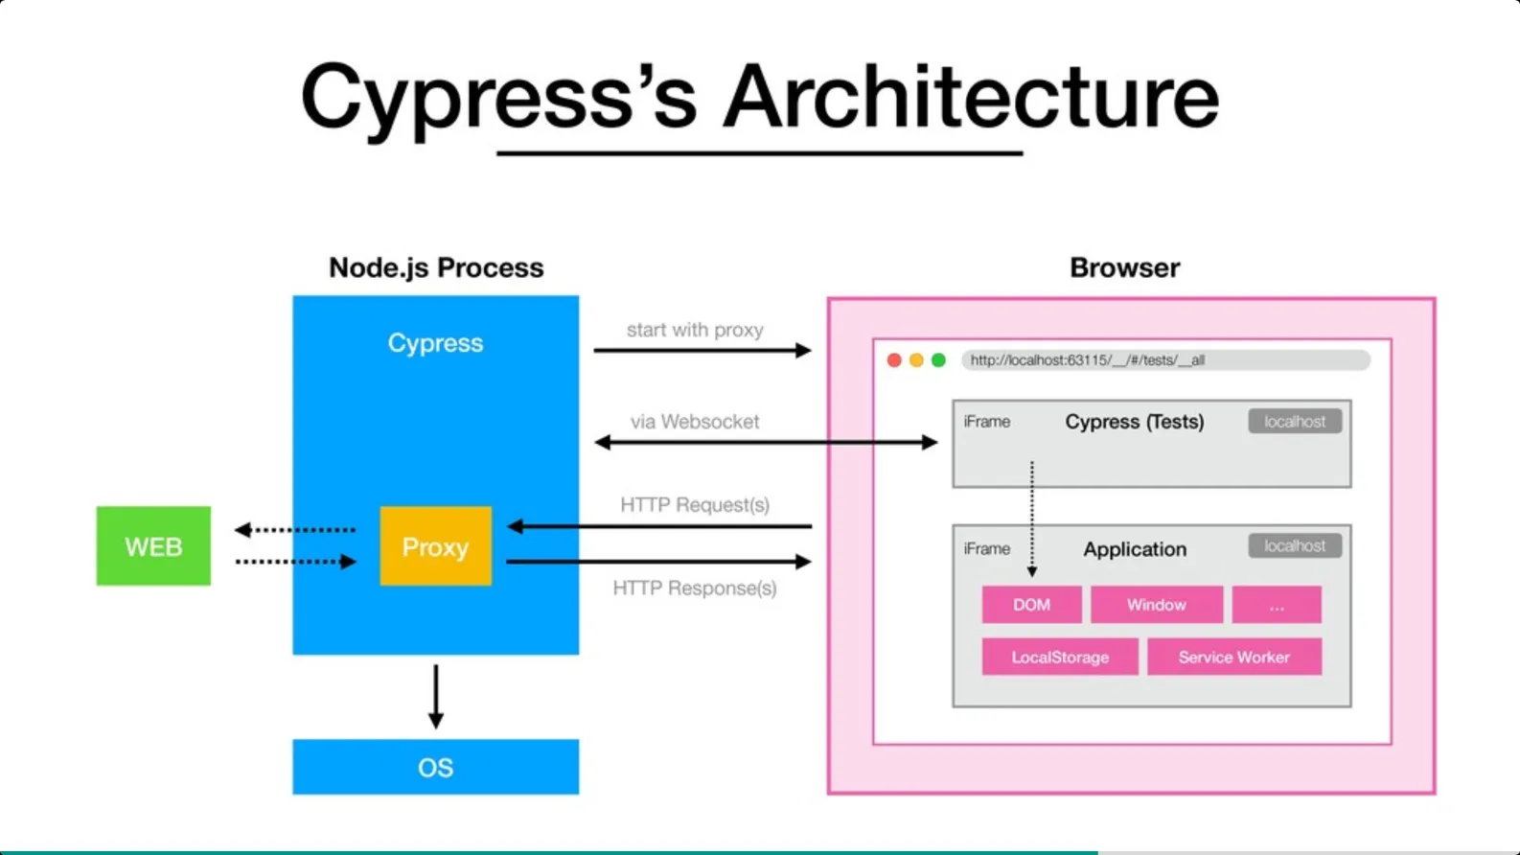
Case Study: Cypress
Cypress is a powerful end-to-end testing framework for web applications.
Its unique architecture sets it apart from other testing tools like Selenium, making it easier to write, debug, and execute tests.

Slide 16
Cypress Architecture Components
1. Node.js Server Process: Backbone of Cypress architecture.
Manages communication between the test runner and the browser.
Handles tasks like file operations, OS interactions, and network operations.
2. Test Runner: Executes tests with real-time visual feedback. It displays test results and offers debugging tools.
3. Browser: Tests run within the browser in the same execution loop as the application.
Enables direct, fast, and accurate interactions compared to tools like Selenium.
4. Network Proxy: Intercepts and modifies network requests/responses.
Supports stubbing, mocking, and simulating network conditions.
5. File System Access: Reads/writes files during testing (e.g., fixtures, logs, screenshots, videos).
6. API and Plugins: Rich API for writing and customizing tests. Plugin system extends functionality for specific testing needs.

Slide 17
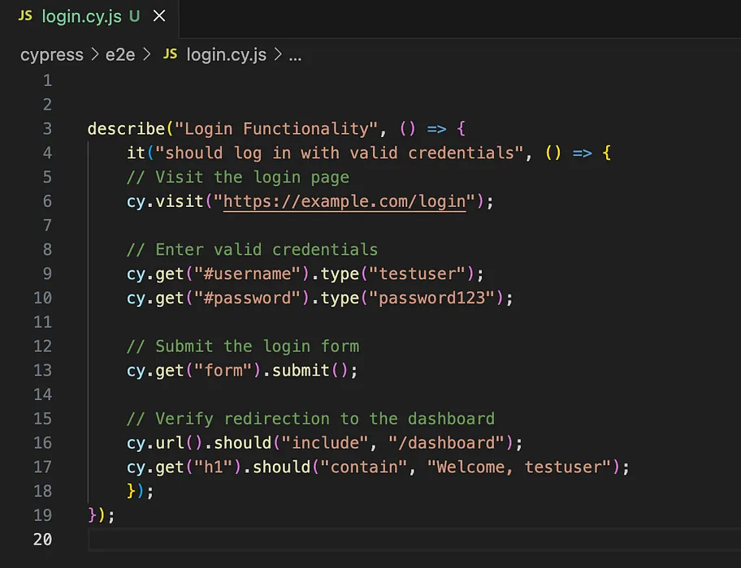
Testing a Login Functionality with Cypress
Step 1: Setup
Install Cypress: npm install cypress --save-dev
Launch Test Runner: npx cypress open
Step 2: Write a Login Test Script
Visit the login page.
Enter valid credentials.
Submit the form
Verify redirection to the dashboard.

Slide 18
Testing a Login Functionality with Cypress – cont’d
Step 3: Running the Test
Execution: Cypress runs the test in the browser via the Test Runner.
Processes Involved (Behind the scenes):
Node.js Server: Initializes the environment.
Test Runner: Loads the test and displays progress.
Browser: Executes test steps like navigating to the login page and interacting with elements.
Network Proxy: Intercepts and stubs network requests, e.g., simulating API responses.
File System: Handles tasks like loading data or saving screenshots.
API/Plugins: Used for user actions like typing credentials and submitting forms.
Step 4: Debugging and Reporting
Debugging Tools:
Pause tests to inspect steps.
View DOM elements and console logs.
Reporting:
Capture screenshots.
Record video of test execution.

Slide 19

Testing Web Page Paths using Cypress

Slide 20
Robot Testing Framework
Robot Framework is a Python-based, extensible keyword-driven automation framework for acceptance testing, acceptance test driven development (ATDD), behavior driven development (BDD) and robotic process automation (RPA).
  Enables easy-to-use tabular syntax for creating test cases in a uniform way.
  Provides easy-to-read result reports and logs in HTML format.
  Is platform and application independent.
  Provides a simple library API for creating customized test libraries which can be implemented natively with Python.
  Provides support for testing web applications, rest APIs, mobile applications, running processes, connecting to remote systems via Telnet or SSH, and so on.
  Supports creating data-driven test cases.
  Has built-in support for variables, practical particularly for testing in different environments.
  Enables easy integration with source control and test suites.
  Provides test-case and test-suite -level setup and teardown.
  The modular architecture supports creating tests even for applications with several diverse interfaces.
  It can be used in distributed, heterogeneous environments, where automation requires using different technologies and interfaces.

Slide 21
Test Management Tools
Test management tools can help with the creation, execution, and tracking of tests. Test management tools also help teams collaborate and share information.
One challenge with test management tools is striking a balance between abstracting away complexity and providing enough detail for debugging test failures.
These tools can be used to track the progress of testing and identify areas where testing needs to be improved.
A test manager is responsible for one or more test engineers. They set test policies, interact with other managers, and support the engineers in testing effectively and efficiently.

Slide 22
Test Management Tools – cont’d
Here are some examples of test management tools:
TestRail can be used to manage test cases and track automation progress. [Conversation History]
Jira can be used to manage test cases and track automation progress. [Conversation History]
ReportPortal is an open-source test report analysis tool that can be used to identify the root causes of test failures.
Zephyr Enterprise is a SaaS test management solution built to help software development and QA teams manage their testing processes. It provides features for creating, organizing, and managing test cases, supporting both manual and automated testing efforts.

Slide 23
Tool Selection
Considerations need to made when selecting a testing tool or framework:
Source Tools: These should make it easier to create workspaces, submit code changes, and enforce style guidelines. They should also be able to browse large codebases and prevent code duplication.
Development Tools: These should include plugins for IDEs that allow them to scale to large codebases and connect with cloud services. They should also allow for fast and high-quality code reviews.
Testing Scope: These should be able to run thousands of web tests in parallel against multiple browsers. They should also be able to abstract away the details of how they work but also provide enough detail for debugging test failures.

Slide 24
Tool Selection
Challenges in Selecting Tools
Tips for Selecting TOOLS
Compatibility: Ensuring the tool works with the product under test.
Usability: Finding tools that are easy to use and maintain.
Affordability: Selecting tools within budget constraints.
Vendor Support: Ensuring reliable support from the tool vendor.
Integration: Seamless integration with the development process.
Staff Training: Training team members on effective tool usage.
Leverage Team Expertise: Choose tools familiar to your team.
Trial Period: Opt for tools with trials or money-back guarantees.
Compatibility Testing: Verify the tool’s compatibility with your product.
Vendor Reliability: Check the vendor’s service and support track record.
Bundle Training: Negotiate training as part of the tool purchase.

Slide 25
Limitations of Software Testing Tools
Exhaustive testing is impossible: The number of potential inputs for most programs is infinite, so it is impossible to test every possible combination. Therefore, testers must prioritize which tests to write and execute even in an automated environment.
Knowing when to stop testing is difficult: Creating too few tests may not reveal enough bugs, while creating too many tests can be ineffective and costly.
  The goal of testing should be to maximize the number of bugs found while minimizing resources spent on finding them, this applies to any tools used for testing.
Testing will never be perfect or enough: Testers must accept that there will always be bugs in software and focus their efforts on finding the most important ones.
Testing tools and technologies cannot replace human testers: Tools and technologies can automate tasks, but human testers are still needed to design test cases, interpret results, and make decisions about the quality of the software.

Slide 26
Best Practices for Software Testing Tools
Focus on User Needs: Design tools to solve user-specific problems.
Select Appropriate Tools: Choose tools based on project requirements and resources.
Automate Tasks: Free testers to focus on creative and complex challenges.
Enhance Testing Quality: Use tools to find more bugs, increase coverage, and cut costs.
Diversify Tools: Combine multiple tools to meet various testing needs.
Boost Collaboration: Facilitate team communication, progress tracking, and issue resolution.
Manage Test Data: Use tools for generating, storing, and organizing test data.
Track Testing Progress: Monitor executed tests, bugs found, and overall testing status.
Support Exploratory Testing: Capture and share findings effectively during sessions.
Integrate with Development: Ensure tools work with source control, build systems, and bug trackers.

Slide 27
Bug Bounties
Bug bounty programs are initiatives where organizations offer financial rewards or recognition to individuals (typically security researchers, ethical hackers, or testers) who find and report vulnerabilities or bugs in their software systems.
How Bug Bounties Work in Software Testing:
Program Setup: Companies set up bug bounty programs, either internally or through platforms like HackerOne, Bugcrowd, or Synack. These programs define the scope of testing, including the software, systems, or applications that can be tested, as well as the specific vulnerabilities or issues that are in scope.
Vulnerability Reporting: Security researchers or testers attempt to find bugs, security vulnerabilities, or flaws in the software based on the defined program rules. They then report the findings to the company through the platform, providing detailed information to help developers fix the issue.
Reward Mechanism: Upon successful identification and validation of a bug, the reporter is rewarded with a bounty, which can vary based on the severity of the issue, the impact on the system, and the complexity of the fix. In some cases, non-financial rewards like recognition or job opportunities are also given.

Slide 28
Bug Bounties – cont’d
Role in Software Testing
External Expertise: Bug bounties tap into a wide pool of testers, uncovering vulnerabilities missed in traditional testing.
Continuous Testing: Ongoing testing post-deployment allows for continuous identification and fixing of vulnerabilities.
Cost-Effective: Bug bounties are more affordable than hiring full-time security experts or doing extensive internal testing.
Benefits
Broader Coverage: Diverse testers increase the likelihood of finding complex bugs.
Real-World Testing: Bugs are discovered in real-world conditions, not just controlled environments.
Faster Discovery: Multiple testers work simultaneously to identify vulnerabilities quickly.
Quality Assurance: Bug bounties complement QA testing by focusing on security.
Challenges
Scope Management: Clear program scope is essential to avoid irrelevant reports.
Quality of Reports: Not all reports are valuable; structured guidelines help improve quality.
Legal and Ethical Concerns: Ethical hacking practices and legal compliance must be ensured.

